Slide 1
MERLIN VENSIYA V
Smart face generative using GAN
3/21/2024 merlin vensi

Slide 2
PROJECT TITLE
Smart face generative using GAN
(Generative adversarial networks)
3/21/2024 Annual Review

Slide 3


AGENDA
Problem statement
Project overview
Who are the end users
my solutions and its value proposition
the wow in my solution
modelling
results
3/21/2024 Annual Review

Slide 4

PROBLEM STATEMENT
Develop a Deep Convolutional Generative Adversarial Network (DCGAN) model to generate realistic human faces. The goal is to train a model on a dataset of human faces to learn the underlying patterns and generate new, unseen faces that are both diverse and realistic.
3/21/2024 Annual Review

Slide 5

PROJECT OVERVIEW
The implementation involves the following steps:
Data Loading and Preprocessing: Load the dataset of human faces and preprocess the images to bring them to a suitable format for training.
Data Visualization: Visualizing the real data from the dataset of human faces.
Model: a. Generator Network: Design and implement the generator network, which takes random noise as input and generates synthetic images resembling human faces. b. Discriminator Network: Develop the discriminator network, which discriminates between real and synthetic images. It is trained to differentiate between the two classes. c. Training: Train the generator and discriminator networks simultaneously in an adversarial manner. The generator aims to generate realistic images that can fool the discriminator, while the discriminator aims to correctly classify real and fake images.
Evaluation: Here the images are subjectively evaluated
3/21/2024 Annual Review

Slide 6

WHO ARE THE END USERS?
Artists & Designers
Game Developers
Filmmakers & Animators
Educators & Researchers
App Developers
Fashion & Makeup Industry
Privacy & Security Researchers
General Public (for digital art, profile pictures, etc.)
3/21/2024 Annual Review

Slide 7

YOUR SOLUTION AND ITS VALUE PROPOSITION
Solution:
A DCGAN model generating realistic human faces.
Value Proposition:
"Effortlessly create diverse and realistic human faces for artists, game developers, filmmakers, educators, app developers, fashion, privacy/security research, and the general public."
3/21/2024 Annual Review

Slide 8

THE WOW IN YOUR SOLUTION
"Revolutionizing face generation with advanced DCGAN technology for unparalleled realism and diversity."
3/21/2024 Annual Review
8

Slide 9
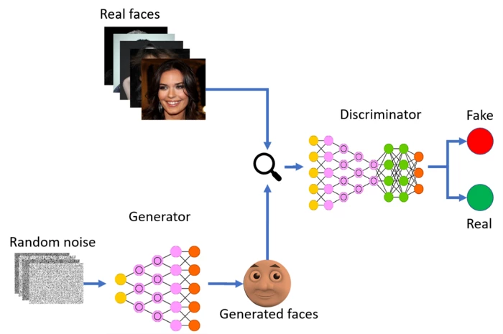
MODELLING
3/21/2024 Annual Review
9

Slide 10
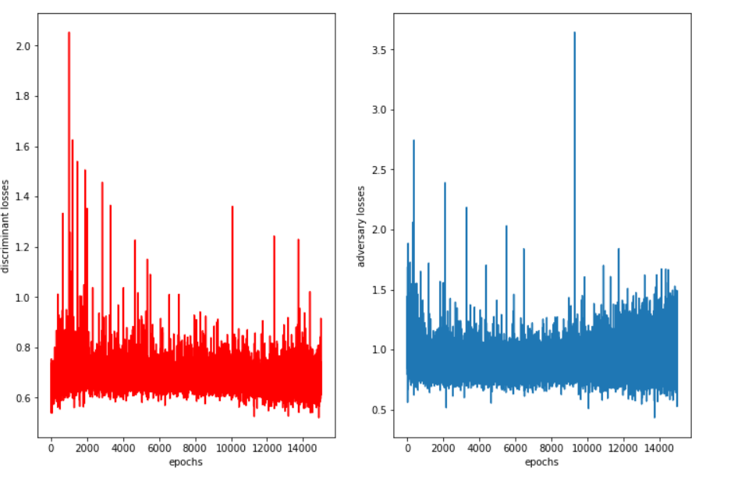
RESULTS
Demo Link
3/21/2024 Annual Review
10

